Slide 1

Power BI - Designing for Accessibility Creating Accessible & Intuitive Reports

Slide 2
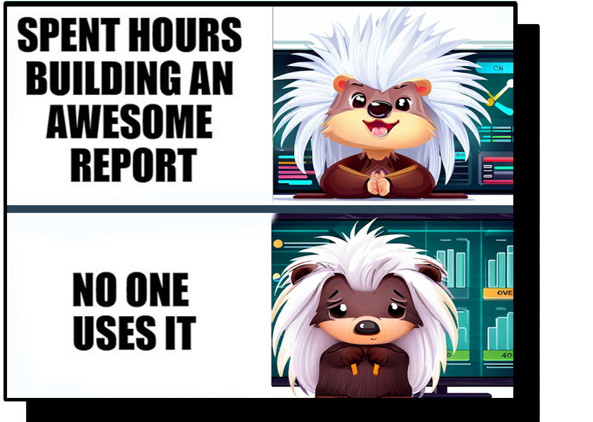

Slide 3


Valerie Junk PorcuBI
Data Analytics & Visualization
Data Storytelling
Process Improvement

Slide 4
Power BI – Design & Accessibility
Intuitive Design
Simple but informative
End-user oriented
Accessibility
Keyboard navigation & tab order
Screen reader & alt text
High Contrast
Focus Mode & Spotlight
Color ratio & check & Themes

Slide 5
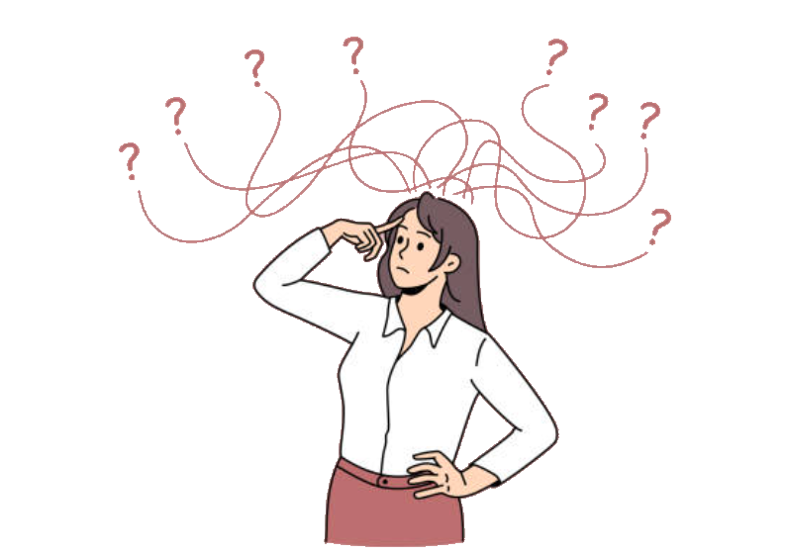

Perfect Report
... the audience just doesn’t get it!

Slide 6

Design for the audience
Who is the audience?
What is their level of experience?
How are they going to use the report?
How much detail do they need (and understand)?
What actions do they want to take?
Notes:
You are not designing for yourself

Slide 7
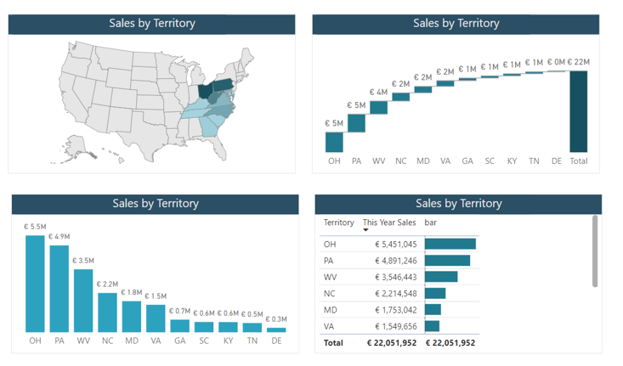
Visual = Goal + enduser
Goal (actions to take) & enduser determine the visual.
Same data can be visualized in different ways.

Slide 8
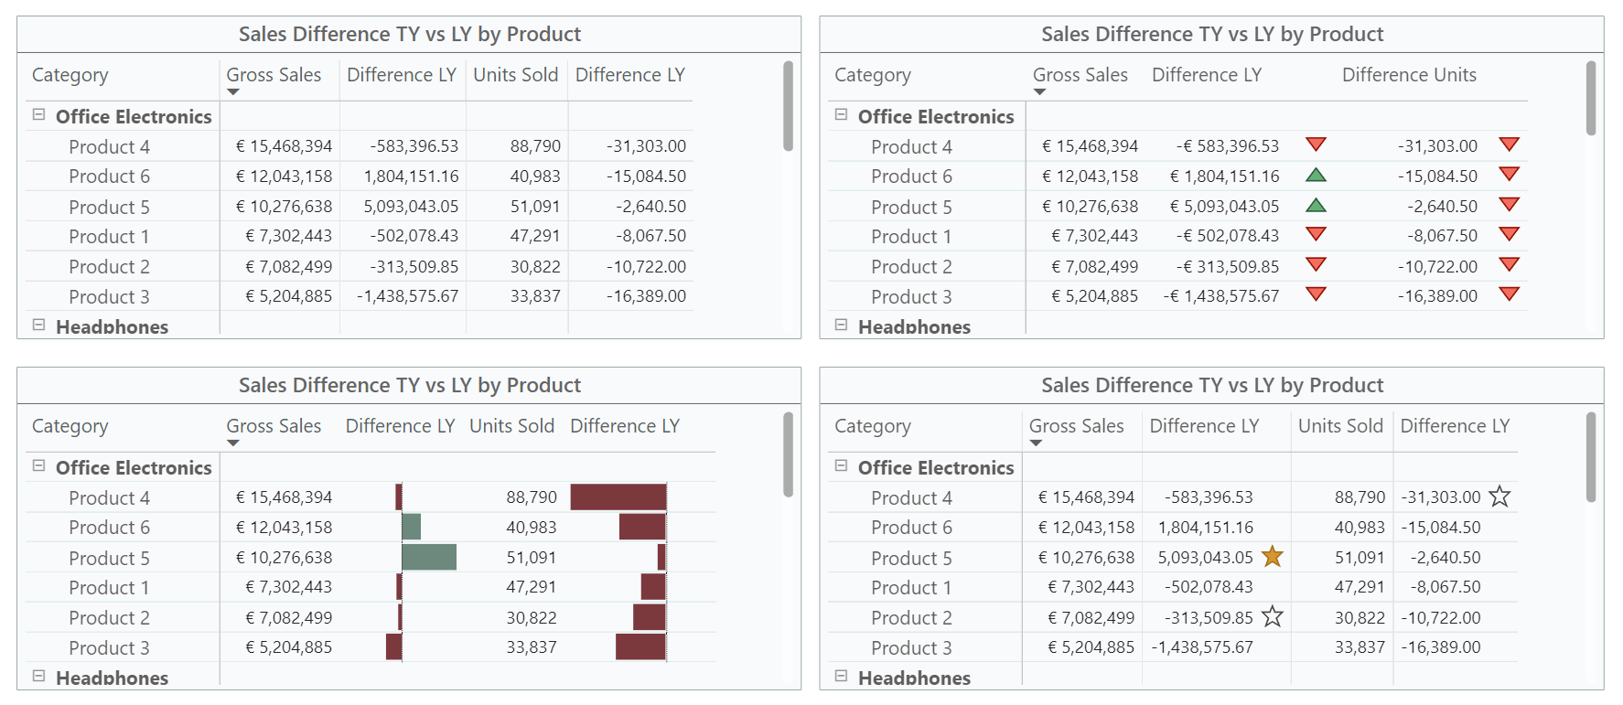
Small changes – huge effect

Slide 9
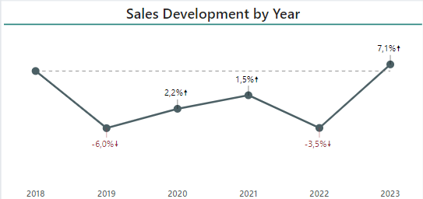
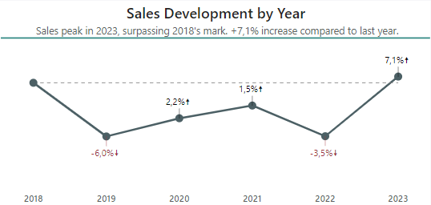
Meaningful (Sub)titles
Provide context
Provide first insights
Guide the end-user
End-users don’t need to analyze data to see results

Slide 10
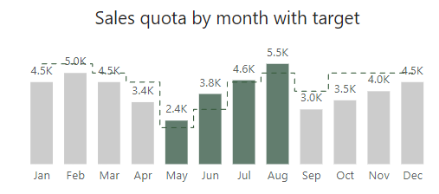
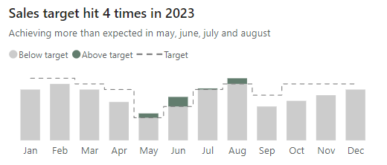
Adding Context
Legend & Colour coding
Notes:
Don’t leave people guessing

Slide 11
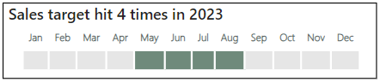
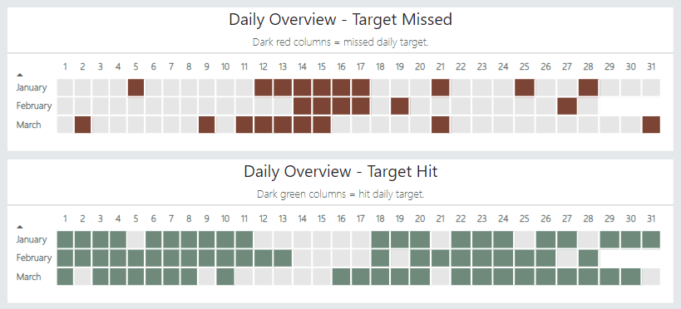
Simplify

Slide 12
Power BI – Design & Accessibility
Intuitive Design
Simple but informative
End-user oriented
Accessibility
Keyboard navigation & tab order
Screen reader & alt text
High Contrast
Focus Mode & Spotlight
Color ratio & check & Themes

Slide 13
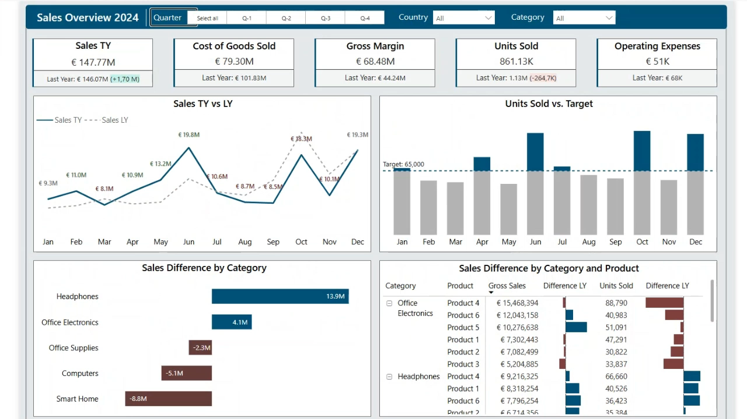
Keyboard navigation

Slide 14
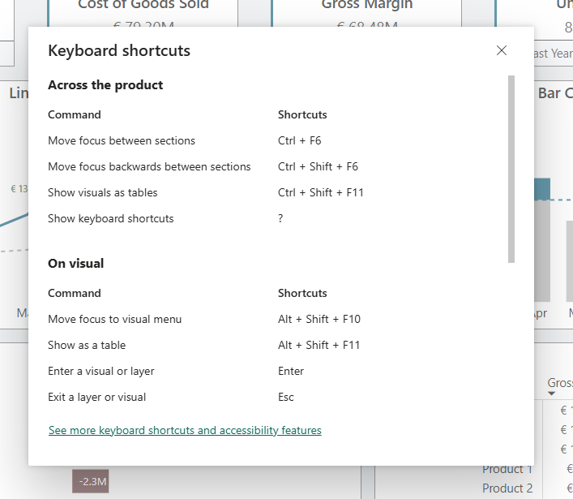
Keyboard navigation
All elements can be navigated using keyboard shortcuts
Shift + ? = Overview shortcuts
Ctrl + F6 = Move between sections
Enter = Enter/Exit a visual
Ctrl + Space = Multi-select data points
Ctrl Shift C = Unselect all filter selections.
Ctrl + Shift + F11 = Show visuals as tables
https://learn.microsoft.com/en-us/power-bi/create-reports/desktop-accessibility-keyboard-shortcuts

Slide 15
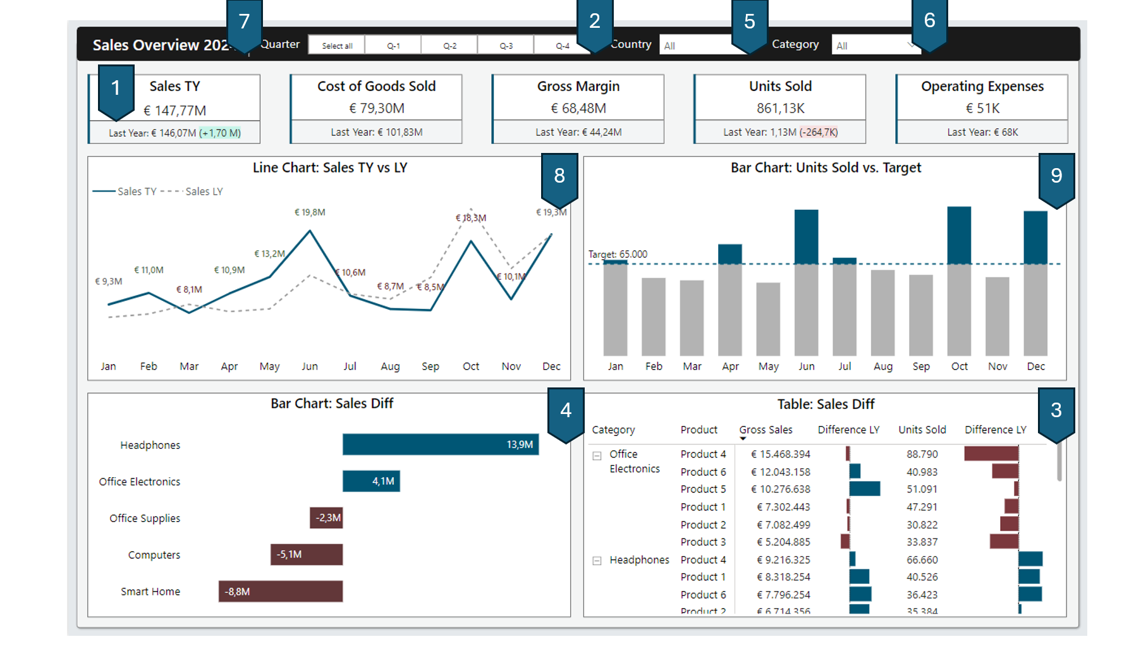
Keyboard navigation not working?

Slide 16
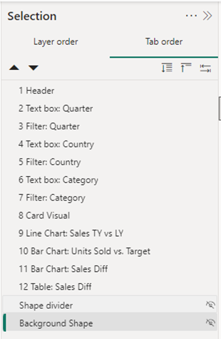
Changing the tab order
View –> Selection –> Tab order
Drag and Drop
Importance of naming elements.
Hide everything you don’t want to use.

Slide 17
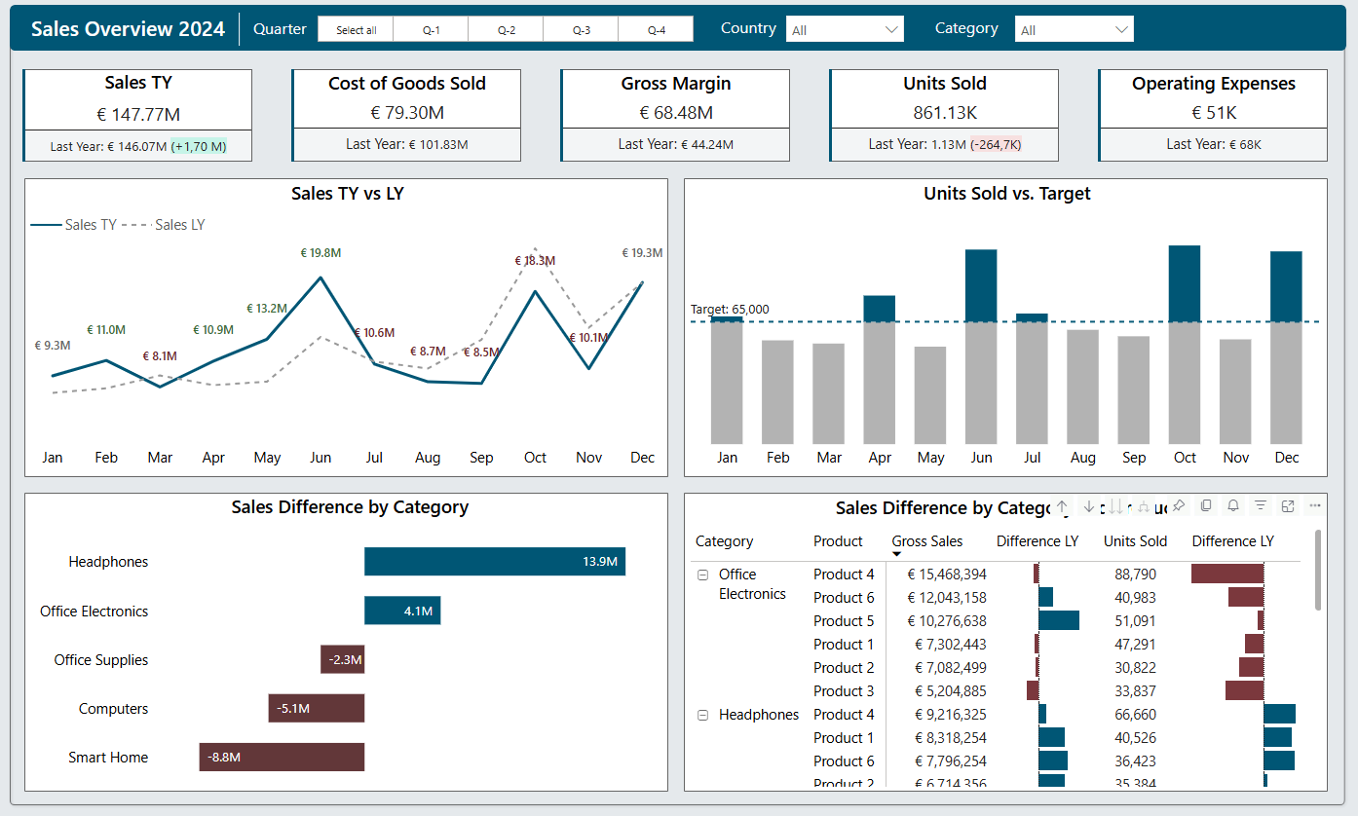
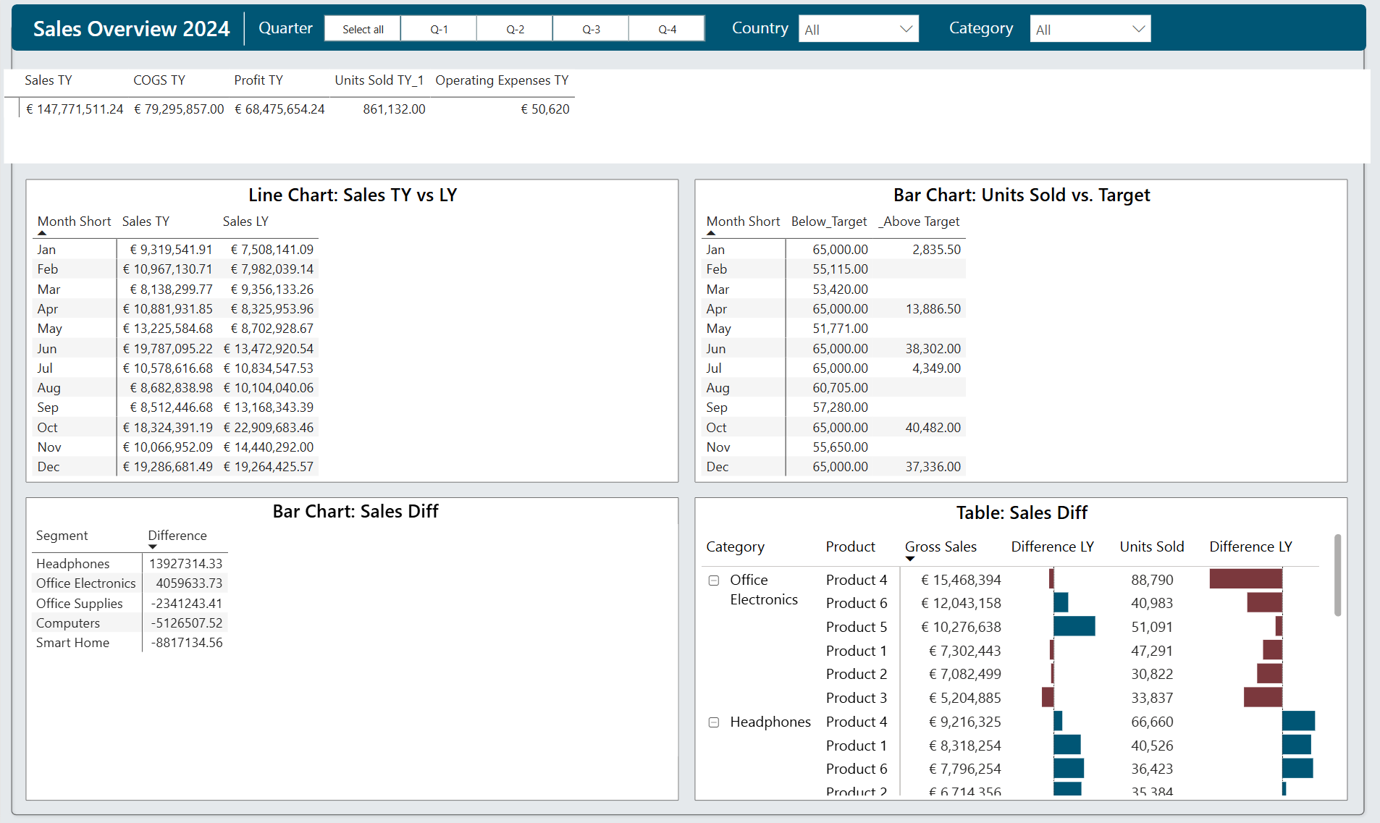
Ctrl + Shift + F11

Slide 18
Check your visuals

Slide 19
Screen reader Compatibility
When a report consumer navigates to a visual, the screen reader will read out:
the title
visual type
any alt text (if set)

Slide 20

Screen reader Compatibility
“img”
Shape with text
“2 items grouping, text box”
Shape and text box grouped
“Sales Data”
Text box

Slide 21
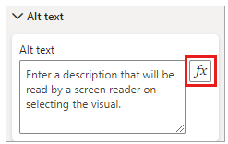
Alt text
Alternative Text
Read by screen readers.
Meaningful information about the element.
Max 250 characters.
Use DAX to make it dynamic.

Slide 22
Alt text example
“img”
Shape with text
“Sales Data img”
Shape with text & alt text “Sales Data”

Slide 23
High-contrast Color View
Power BI has standard high-contrast support for reports!
You can choose from 4 options.
High-contrast #1
High-contrast #2
High-contrast Black
High-contrast White

Slide 24
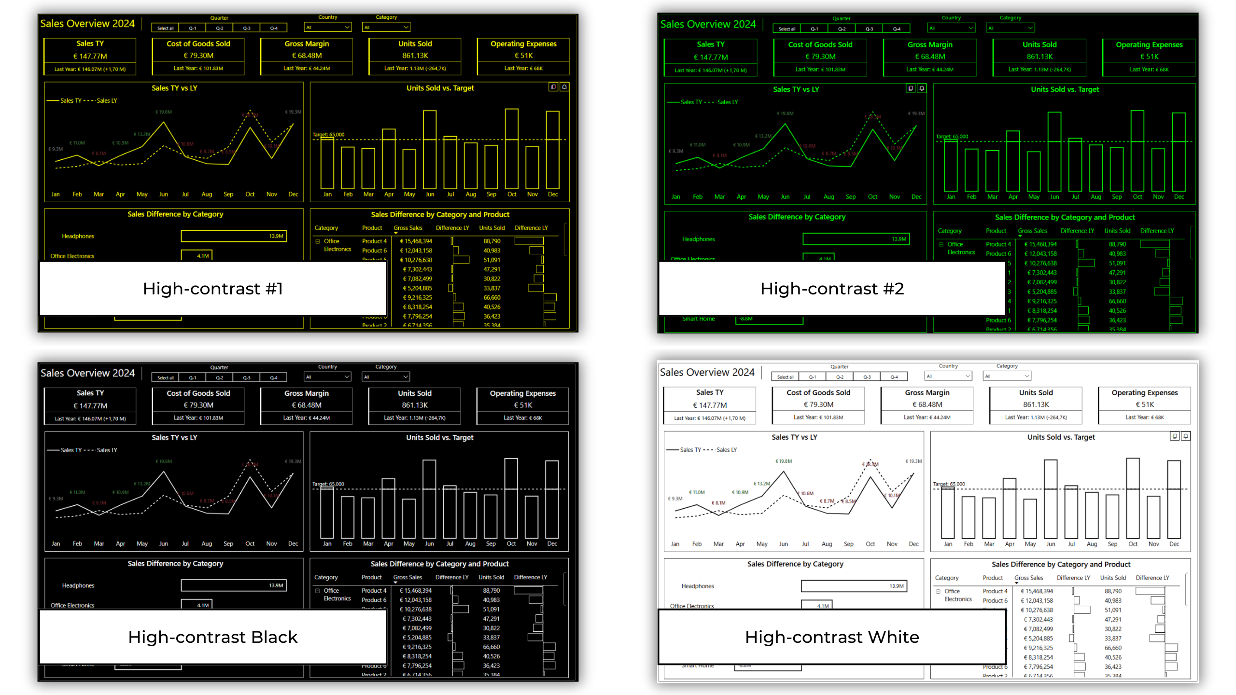
High-contrast Color View

Slide 25
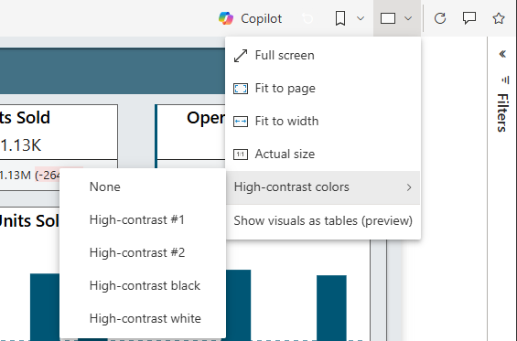
High-contrast Color View
You can set the view in Power BI (online).
"View" button -> "High-contrast colors."

Slide 26
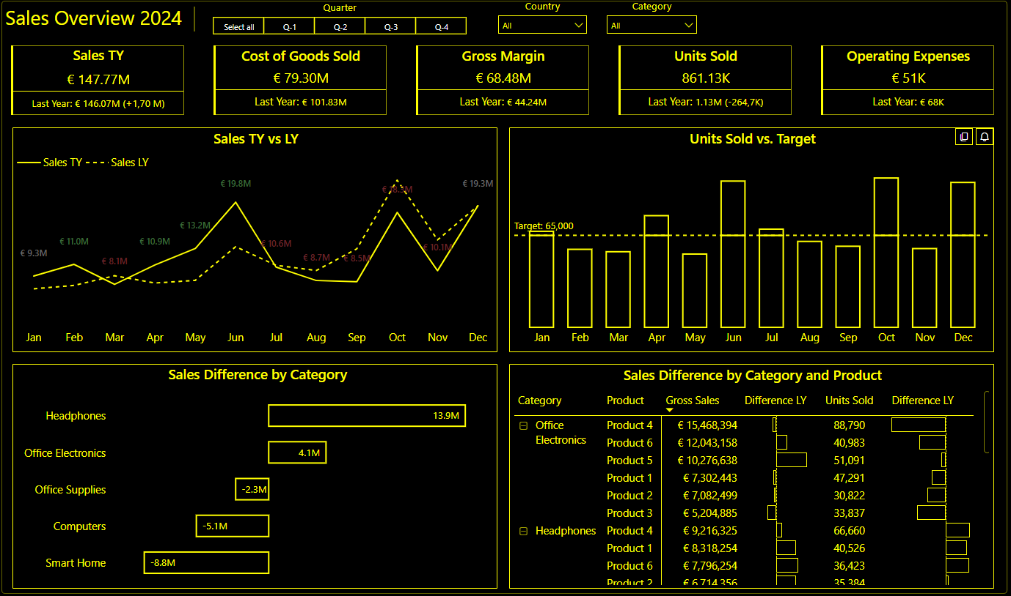
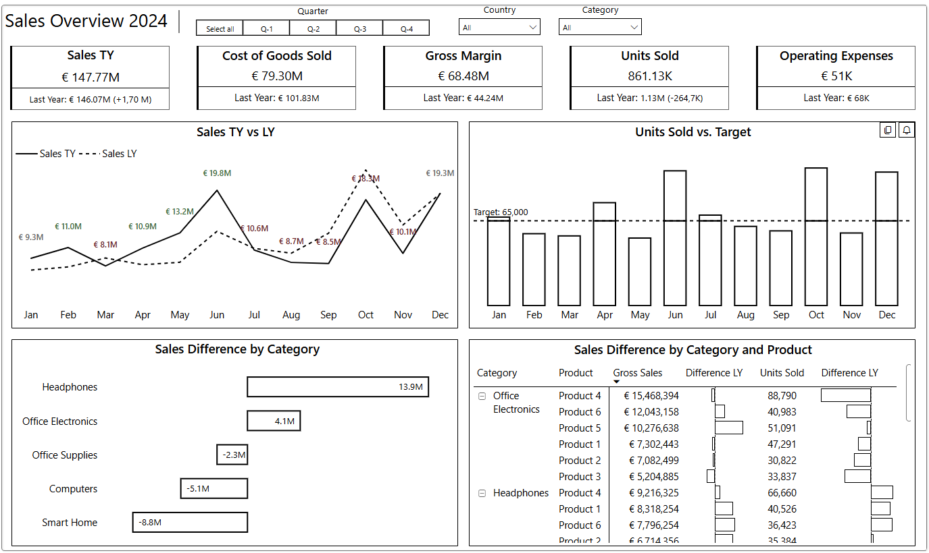
High-contrast Color View
Word of warning: Conditional formatting is not changed!

Slide 27
Spotlight Focus mode Show data table
Can be done
by the user!

Slide 28
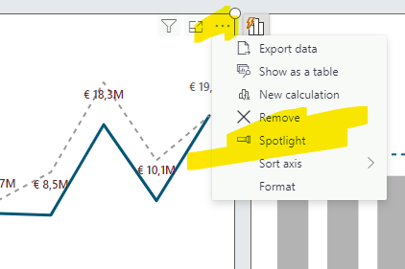
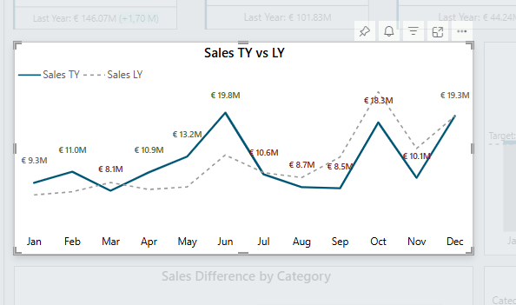
Spotlight
Focus on one visual in the report

Slide 29
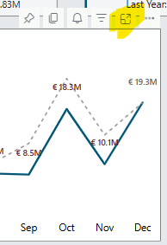
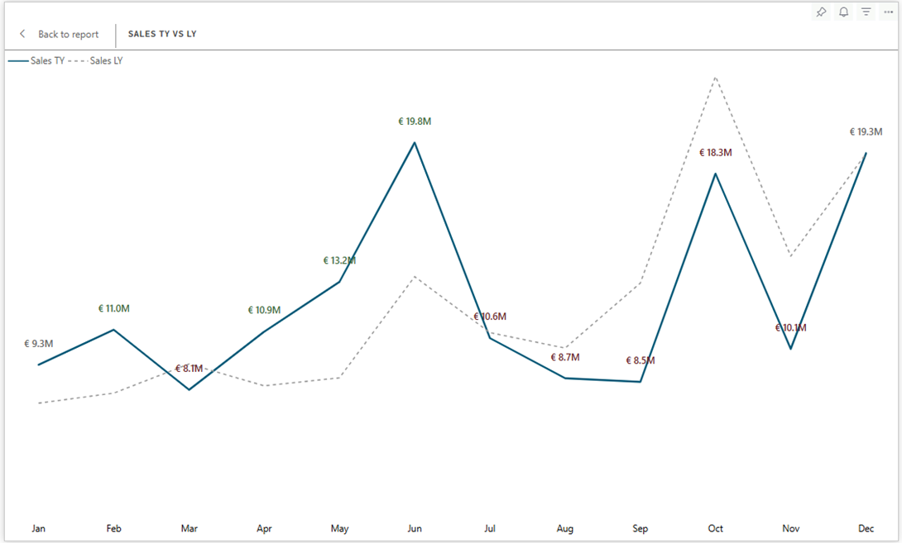
Focus Mode
New window to view the visual

Slide 30
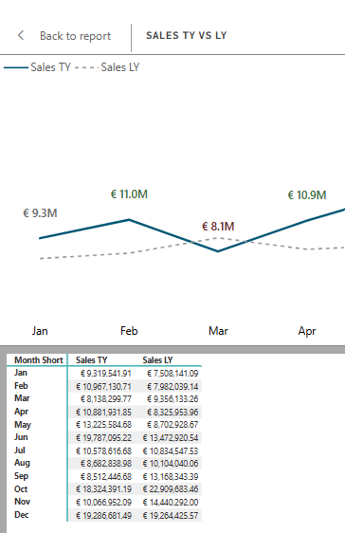
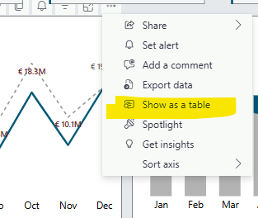
Show as table
Visual and table combined
Alt + Shift + F11 for screen-reader friendly view

Slide 31
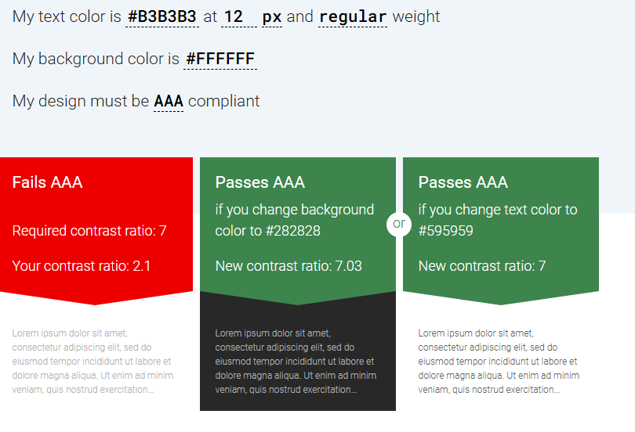
Colorblind friendly colors
Background & text contrast ratio at least 4.5:1
The lighter color (background)
is 4.5 times brighter than
the darker color (text).
The text is distinguishable
from the background
https://accessible-colors.com/

Slide 32
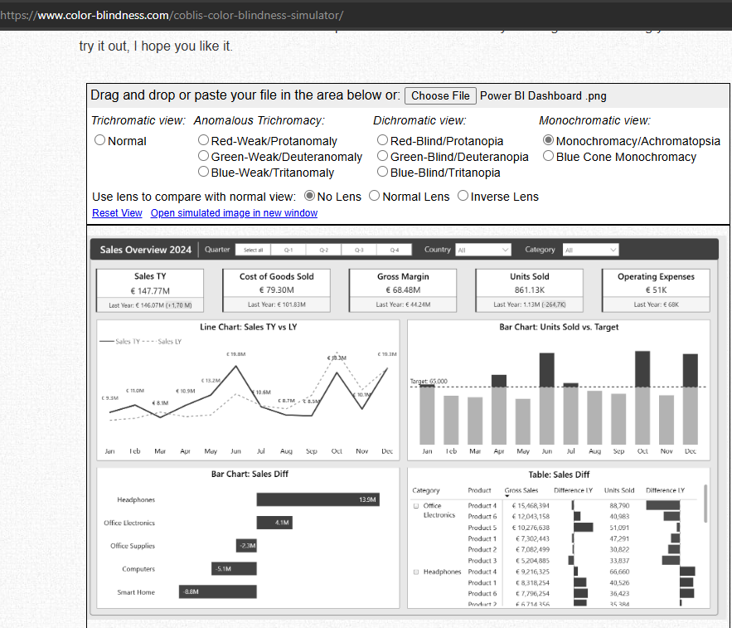
Color check
www.color-blindness.com
Squint test
Turn down the brightness of screen
Do you still see the most important information?
Check with the end-user

Slide 33

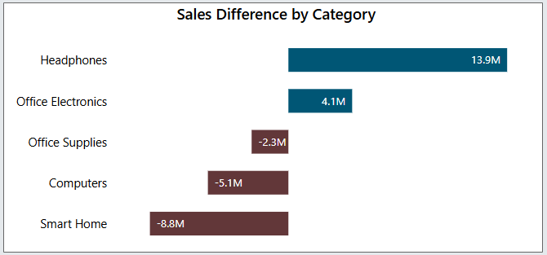
Don’t rely on color only
Difficult color combinations
green and red
green and brown
blue and purple
green and blue
light green and yellow
blue and grey
green and grey
green and black

Slide 34
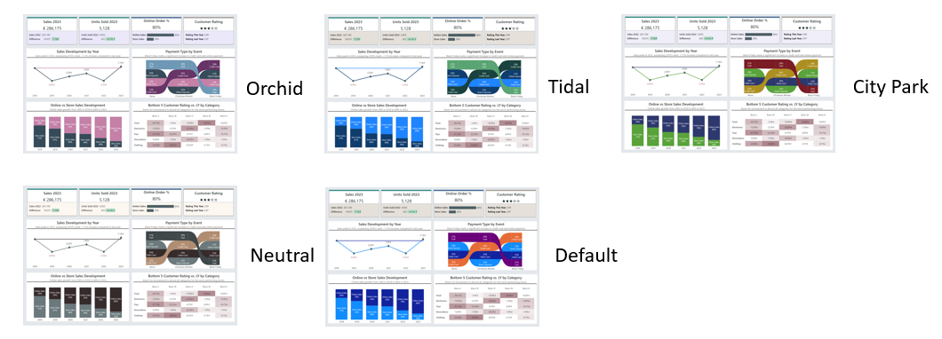
Accessibility Themes
*this only works when you have not set the colors manually (or with conditional formatting)

Slide 35
Takeaway
Design for the audience
Goal + Enduser = Visual
Provide context & meaning
Accessibility is not a buzzword
Do not just use color to convey information but also text & icons.
Add alternative text
Check the tab order.

Slide 36




Contact
info@porcubi.nl
https://www.linkedin.com/in/valeriejunk/
@porcubi
https://www.youtube.com/@PorcuBI

